Slide 2
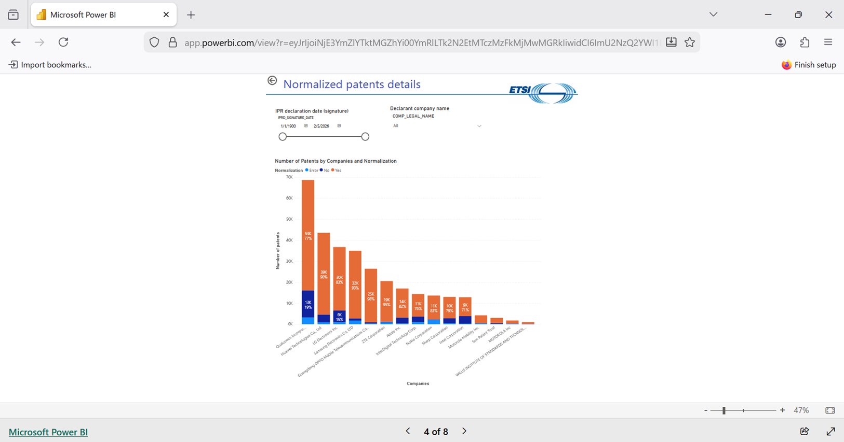
公式の分析ツール
ETSI Power BI reportから、企業毎の宣言数が確認可能である。

Slide 3
IPR reporting dataにおける各レコードの内容
IPRD_ID | 2381 | WOIT_REFERENCE | RTS/TSGR-0236300vc40 | Illustrative_Part | Section 4.9, 6.1.2.2, 6.1.3.2, 6.5, 7.6, 10.1.2.8.1
IPRD_REFERENCE | ISLD-201608-010 | WOIT_VERSION | 12.4.0 | DIPG_PATF_ID | 20438
IPRD_SIGNATURE_DATE | 2016/8/31 | 3GPP_Type | TS | Original_Application_Number | -1
Reflected_Date | 2016/10/6 | TGPP_NUMBER | 36.3 | Original_Publication_Number | -1
COMP_LEGAL_NAME | NTT DOCOMO INC | TGPV_VERSION | 12.4.0 | Explicitely_Disclosed | 1
DECL_IS_PROP_FLAG | 1 | Patent_Type | Family Member | Normalized_Patent | 1
LICD_DEC_PREP_TO_GRANT_FLAG | 1 | PATT_APPLICATION_NUMBER | CN2013832490 | 2G | 0
LICD_REC_CONDI_FLAG | 1 | PUBL_NUMBER | CN104396293 A | 3G | 0
DIPG_ID | 43483 | PBPA_TITLEEN | Radio communication system and base station | 4G | 1
DIPG_DISPLAY_NUMBER | 1 | PBPA_PRIORITY_NUMBERS | |JP20120140900|WO2013JP63391| | 5G | 0
DIPG_EXTERNAL_ID | -1 | Country_Of_Registration | CN CHINA
Standard | TS 136 300 (RTS/TSGR-0236300vc40) version 12.4.0 -- 3GPP TS 36.300 version 12.4.0 | PBPA_APP_DATE | 2013/5/14
Ess_To_Standard | 1 | ETPR_ID | 876
WI_Type | TS | ETPR_ACRONYM | 3GPP-Release-12 | GSM Phase 2+ and UMTS/LTE/LTE-Advanced release 12
WOIT_ETSI_DELIVERABLE_NUMBER | 136 300 | Ess_To_Project | 1
IPR宣言の番号（IPRD_REFERENCE）、特許文献の番号（PUBL_NUMBER）、優先権を主張している文献番号（PBPA_PRIORITY_NUMBERS）なども確認可能。

Slide 4
分析の基準を考える
IPRD_ID | 2381 | 2381 | 2381 | 2381
IPRD_REFERENCE | ISLD-201608-010 | ISLD-201608-010 | ISLD-201608-010 | ISLD-201608-010
IPRD_SIGNATURE_DATE | 2016-08-31 | 2016-08-31 | 2016-08-31 | 2016-08-31
COMP_LEGAL_NAME | NTT DOCOMO INC | NTT DOCOMO INC | NTT DOCOMO INC | NTT DOCOMO INC
DIPG_ID | 43483 | 43483 | 43483 | 43483
Patent_Type | Family Member | Family Member | Basis Patent | Family Member
PATT_APPLICATION_NUMBER | CN2013832490 | WO2013JP63391 | JP20120140900 | US201314406757
PUBL_NUMBER | CN104396293 A | WO2013190929 A1 | JP2014007500 A | JP5758352 B2 | US2015172963 A1 | US9344922 B2
PBPA_PRIORITY_NUMBERS | |JP20120140900|WO2013JP63391| | |JP20120140900| | |JP20120140900| | |JP20120140900|WO2013JP63391|
Country_Of_Registration | CN CHINA | WO Patent Cooperation Treaty | JP JAPAN | US UNITED STATES
PBPA_APP_DATE | 2013-05-14 | 2013-05-14 | 2012-06-22 | 2013-05-14
ETPR_ID | 876 | 876 | 876 | 876
DIPG_PATF_ID | 20438 | 20438 | 20438 | 20438
DIPG_ID（IPRデータベースにおける開示特許グループの一意の数値識別子）を基準に、分析する。（宣言書の付属書における1つの開示「ブロック」に対応する。）

Slide 5
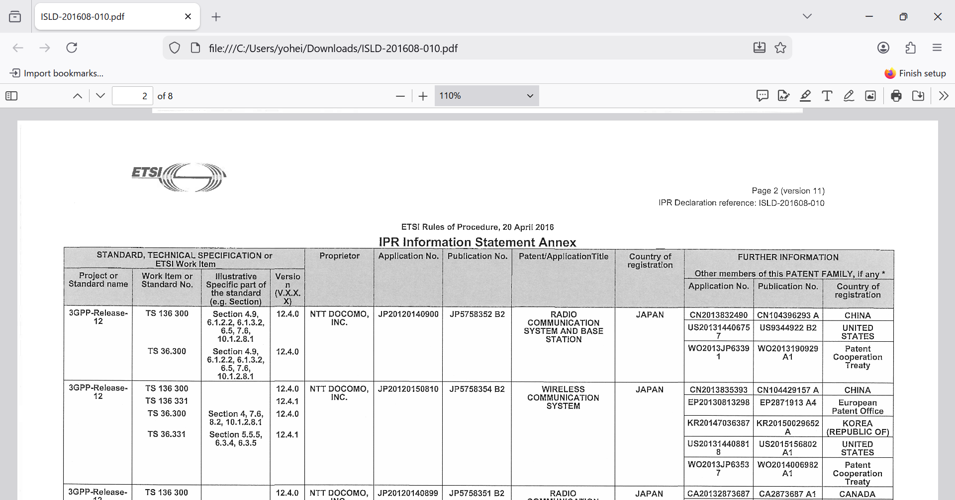
IPR INFORMATION STATEMENT AND LICENSING DECLARATIONの内容
ISLD-201608-010という宣言を実際に確認する。

Slide 6
分析の基準を考える
IPRD_ID | 2381 | 2381 | 2381 | 4213 | 4301 | 4252 | 4252 | 4213
IPRD_REFERENCE | ISLD-201608-010 | ISLD-201608-010 | ISLD-201608-010 | ISLD-201906-021 | ISLD-201907-041 | ISLD-201907-008 | ISLD-201907-008 | ISLD-201906-021
COMP_LEGAL_NAME | NTT DOCOMO INC | NTT DOCOMO INC | NTT DOCOMO INC | NTT DOCOMO INC | NTT DOCOMO INC | NTT DOCOMO INC | NTT DOCOMO INC | NTT DOCOMO INC
DIPG_ID | 43483 | 43483 | 43483 | 83279 | 90289 | 87420 | 87420 | 83279
PATT_APPLICATION_NUMBER | CN2013832490 | WO2013JP63391 | JP20120140900 | JP20120140900 | JP20120140900 | US201314406757 | WO2013JP63391 | CN2013832490
PUBL_NUMBER | CN104396293 A | WO2013190929 A1 | JP2014007500 A | JP5758352 B2 | JP2014007500 A | JP5758352 B2 | JP2014007500 A | JP5758352 B2 | US2015172963 A1 | US9344922 B2 | WO2013190929 A1 | CN104396293 A
PBPA_TITLEEN | Radio communication system and base station | RADIO COMMUNICATION SYSTEM AND BASE STATION | RADIO COMMUNICATION SYSTEM AND BASE STATION | RADIO COMMUNICATION SYSTEM AND BASE STATION | RADIO COMMUNICATION SYSTEM AND BASE STATION | RADIO COMMUNICATION SYSTEM AND BASE STATION | RADIO COMMUNICATION SYSTEM AND BASE STATION | Radio communication system and base station
PBPA_PRIORITY_NUMBERS | |JP20120140900|WO2013JP63391| | |JP20120140900| | |JP20120140900| | |JP20120140900| | |JP20120140900| | |JP20120140900|WO2013JP63391| | |JP20120140900| | |JP20120140900|WO2013JP63391|
Country_Of_Registration | CN CHINA | WO Patent Cooperation Treaty | JP JAPAN | JP JAPAN | JP JAPAN | US UNITED STATES | WO Patent Cooperation Treaty | CN CHINA
ETPR_ID | 876 | 876 | 876 | 1228 | 1228 | 1228 | 1228 | 1228
Illustrative_Part | Section 4.9, 6.1.2.2, 6.1.3.2, 6.5, 7.6, 10.1.2.8.1 | Section 4.9, 6.1.2.2, 6.1.3.2, 6.5, 7.6, 10.1.2.8.1 | Section 4.9, 6.1.2.2, 6.1.3.2, 6.5, 7.6, 10.1.2.8.1 | -1 | Section 10.2.1 | -1 | -1 | -1
DIPG_PATF_ID | 20438 | 20438 | 20438 | 20438 | 20438 | 20438 | 20438 | 20438
次頁へ続く。

Slide 7
分析の基準を考える
IPRD_ID | 4213 | 4213 | 4301 | 4301 | 4252 | 2381 | 4252 | 4301
IPRD_REFERENCE | ISLD-201906-021 | ISLD-201906-021 | ISLD-201907-041 | ISLD-201907-041 | ISLD-201907-008 | ISLD-201608-010 | ISLD-201907-008 | ISLD-201907-041
COMP_LEGAL_NAME | NTT DOCOMO INC | NTT DOCOMO INC | NTT DOCOMO INC | NTT DOCOMO INC | NTT DOCOMO INC | NTT DOCOMO INC | NTT DOCOMO INC | NTT DOCOMO INC
DIPG_ID | 83279 | 83279 | 90289 | 90289 | 87420 | 43483 | 87420 | 90289
PATT_APPLICATION_NUMBER | US201314406757 | WO2013JP63391 | US201314406757 | WO2013JP63391 | JP20120140900 | US201314406757 | CN2013832490 | CN2013832490
PUBL_NUMBER | US2015172963 A1 | US9344922 B2 | WO2013190929 A1 | US2015172963 A1 | US9344922 B2 | WO2013190929 A1 | JP2014007500 A | JP5758352 B2 | US2015172963 A1 | US9344922 B2 | CN104396293 A | CN104396293 A
PBPA_TITLEEN | RADIO COMMUNICATION SYSTEM AND BASE STATION | RADIO COMMUNICATION SYSTEM AND BASE STATION | RADIO COMMUNICATION SYSTEM AND BASE STATION | RADIO COMMUNICATION SYSTEM AND BASE STATION | RADIO COMMUNICATION SYSTEM AND BASE STATION | RADIO COMMUNICATION SYSTEM AND BASE STATION | Radio communication system and base station | Radio communication system and base station
PBPA_PRIORITY_NUMBERS | |JP20120140900|WO2013JP63391| | |JP20120140900| | |JP20120140900|WO2013JP63391| | |JP20120140900| | |JP20120140900| | |JP20120140900|WO2013JP63391| | |JP20120140900|WO2013JP63391| | |JP20120140900|WO2013JP63391|
Country_Of_Registration | US UNITED STATES | WO Patent Cooperation Treaty | US UNITED STATES | WO Patent Cooperation Treaty | JP JAPAN | US UNITED STATES | CN CHINA | CN CHINA
ETPR_ID | 1228 | 1228 | 1228 | 1228 | 1228 | 876 | 1228 | 1228
Illustrative_Part | -1 | -1 | Section 10.2.1 | Section 10.2.1 | -1 | Section 4.9, 6.1.2.2, 6.1.3.2, 6.5, 7.6, 10.1.2.8.1 | -1 | Section 10.2.1
DIPG_PATF_ID | 20438 | 20438 | 20438 | 20438 | 20438 | 20438 | 20438 | 20438
DIPG_PATF_ID （ IPR データベース内の開示の ETSI 特許ファミリの一意の数値識別子）を基準に、分析する。

Slide 8


データベースの構造
Basis Patent
Family Member
LICENSING DECLARATION
JP20120140900
JP20120140900
JP20120150810
ISLD-201608-010
JP20120140900
JP20120140899
JP20120201344
JP20120140900

Slide 9


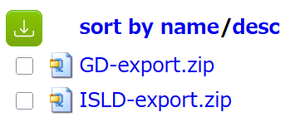

処理するアルゴリズム
“3G”,“4G”,“5G”=1(各世代)
正規化
テーブル
Ess_To_Standard == 1
Ess_To_Project == 1
DIPG_PATF_ID != -1
Normalized_Patent == 1
Country_Of_Registration == "JP JAPAN"
フィルタ後
テーブル
IPRD_REFERENCE / IPRD_ID / DIPG_ID / DIPG_PATF_IDを一意にする。
COMP_LEGAL_NAMEでcountする。
円グラフ
一意な
テーブル

